Slide 1

System Administration-CSNW3202-ITNT403
Chapter 3:Working with Files and Directories
• Understanding Command-Line Basics
• Exploring Files and Directories
• Working with test editor (nano, vi etc)
• Redirecting Input and Output
• Piping Data between Programs
• Processing Text Using Filters
• File-Combining Commands
• File-Transforming Commands
• File-Viewing Commands
• Using grep utility

Slide 2
Understanding Command-Line Basics
The command-line interface (CLI) is a text-based way of interacting with a computer.
What is a Command?
A program executed on the command line.
For example,
date command is used to display current date with time.
echo "Today date is ";date
echo "Today date is `date`"
Note:The echo command is used to display text or variables in the command-line interface (CLI).
`date` used to execute a command and replace it with its output.
cal command is to display calendar.
echo "Current month is ";cal
echo "Current month is `cal`"
Note: ; symbol referring run more than one command on terminal
pwd (Print Working Directory) command in Linux is used to display the current directory in which the user is working.
echo "The current directory path is ";pwd
echo "The current directory path is `pwd`"
whoami command in Linux displays the current logged-in user. It is useful for verifying which user is executing commands in a terminal.
echo "The current user is ";whoami
echo "The current user is `whoami`"
clear command is used to clear the screen.

Slide 3

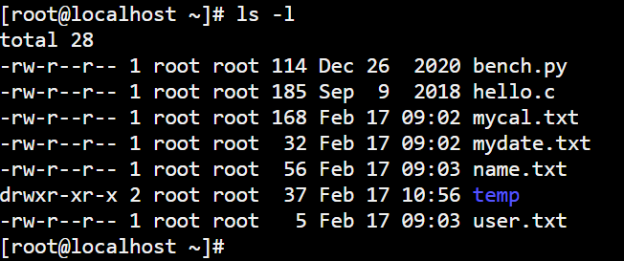
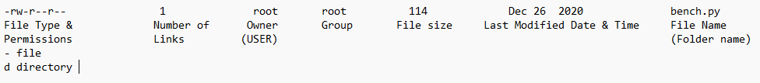
Exploring Files and Directories
Linux provides a powerful set of commands to navigate and manage files and directories efficiently. This topic covers essential commands for navigation, listing, searching, managing, and viewing files and directories.
Exploring Files and Directories
List Files and Directories
Displays the contents of the current directory.
ls
The ls -l command is used to display a detailed (long format) list of files and directories in a directory. It provides permissions, ownership, file size, and modification time.
ls -l – Long Format Listing

Slide 4
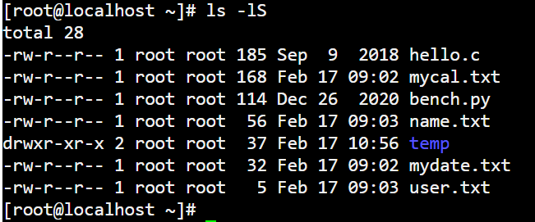
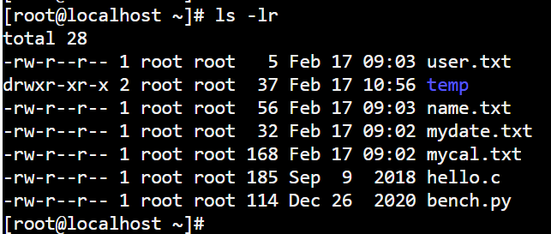
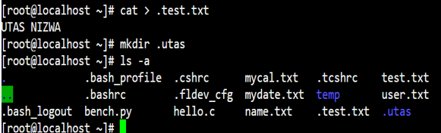
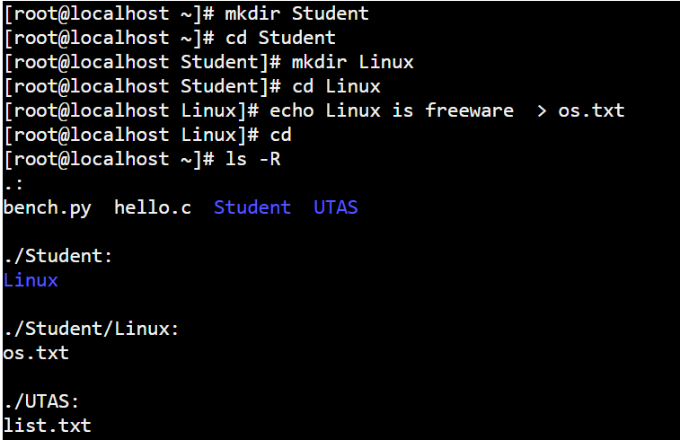
Exploring Files and Directories
Linux provides a powerful set of commands to navigate and manage files and directories efficiently. This topic covers essential commands for navigation, listing, searching, managing, and viewing files and directories.
Exploring Files and Directories Sort by file size (largest first) ls -lS
List Files and Directories
Reverse(DECENDING) the order of the listing
ls -lr
ls -lr
Create hidden file and folder
Show Hidden Files.
Displays files or folder starting with . (dot), which are hidden by default.
Show Hidden Files ls –a
Displays files or folder starting with . (dot), which are hidden by default.
List all files, including hidden ones.
ls -la
Lists the contents of the subdirectories
ls –R

Slide 5

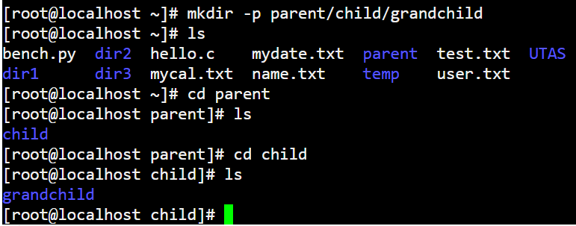
Creating and Removing Files and Directories
Create a Directory
mkdir my_folder
To create multiple directories at once:
mkdir dir1 dir2 dir3
mkdir UTAS
Remove an Empty Directory
rmdir – Remove an Empty Directory
rmdir empty_folder
Create Parent Directories (-p Option)

Slide 6
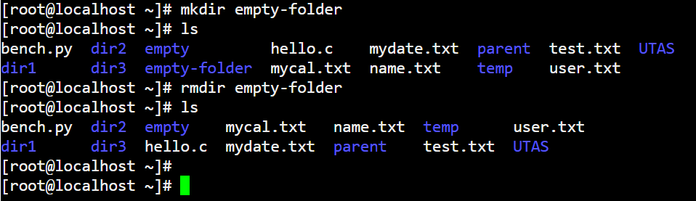
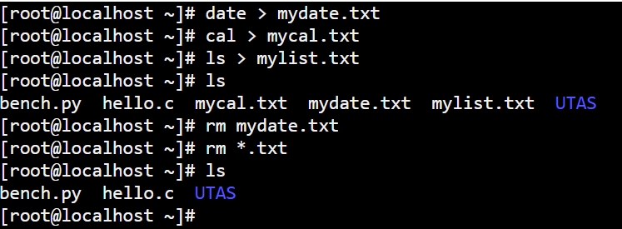
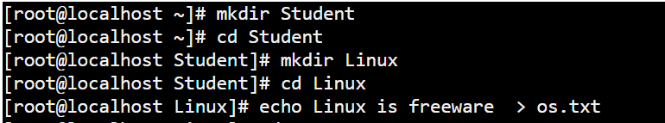
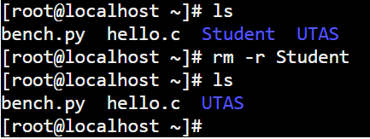
Remove an Empty Directory
rmdir – Remove an Empty Directory Remove Files or Directories
Remove Directories rm –r Remove the directory and its contents. r option is recursive.
-f option(Force) –Ignores warning messages and forces deletion.
Remove the directory sample and its contents with out giving warning for write-protected files.
rm –f sample
Delete All Files of a Specific Type-Removes all .log files in the current directory and sub directory.
rm -rf *.log

Slide 7
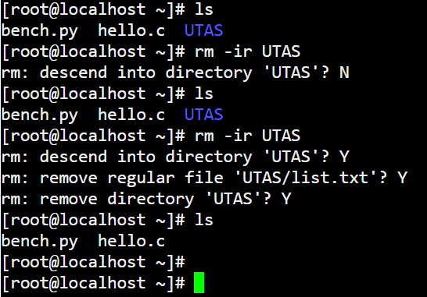
The rm -ir command is used to interactively delete files and directories while asking for confirmation before deletion.
-i (Interactive Mode) → Prompts the user before deleting each file.
-r (Recursive Mode) → Allows deletion of directories and their contents
cd command is used to change directory
cd /usr/tmp Change current working directory to /usr/tmp
cd Change to user’s home directory
cd / Change to root directory
cd .. Change to directory one level up (Parent directory)
cd ~ Change to user’s home directory

Slide 8
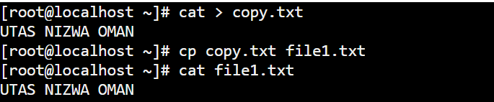
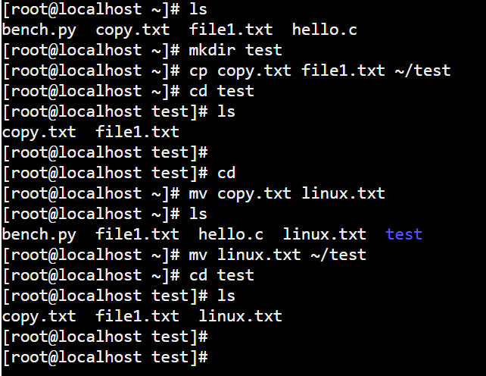
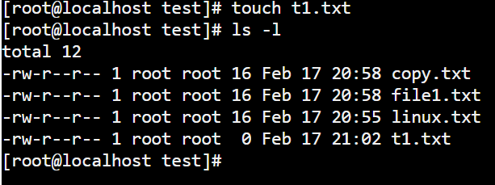
cp command is used to Copy files and directories
cp file1 file2 Copy file1 to file2
cp file1 file2 /tmp Copy file1 and file2 to the /tmp directory
mv command is used to Move or rename files and directory
mv file2 /temp file2 is moved to directory /tmp
mv file1 file2 file1 is changed name to file2
Create an Empty File
touch newfile.txt
touch t1.txt;touch t2.txt;touch t3.txt

Slide 9
Working with test editor (nano, vi etc)
Nano Editor in Linux
The Nano text editor is a simple and user-friendly command-line text editor for Linux. It is pre-installed in most Linux distributions and is an excellent choice for quick file editing.
1. Open the file with Nano:
nano myfile.txt
nano –l myfile.txt
l is line number
2. Start typing or editing text.
Save the changes by pressing:
CTRL + O (Write Out)
Press Enter to confirm.
3. Exit Nano using:
CTRL + X
Press Y to save, or N to exit without saving.
CTRL + O Save file
CTRL + X Exit Nano
CTRL + G Help menu
CTRL + K Cut a line
CTRL + U Paste a line

Slide 10
Redirecting Input and Output
Standard Output (stdout) Redirection → > and >>
By default, Linux commands display output on the terminal (stdout). You can redirect this output to a file.
🔹 Overwriting a File (> Operator)
ls > output.txt
✅ This saves the output of ls in output.txt, overwriting the file if it already exists.
🔹 Appending to a File (>> Operator)
ls >> output.txt
Linux provides powerful input/output (I/O) redirection features that allow you to control where data comes from and where it goes.
Examples,
echo "See this is the first line" > file.txt
echo "See this is the second line" >> file.txt
cat file.txt

Slide 11
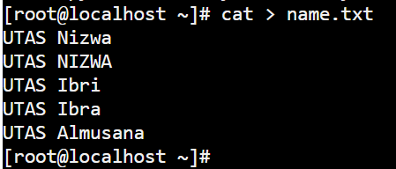
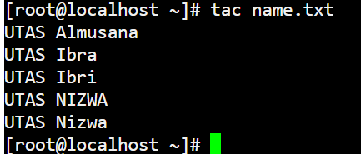
Processing Text Using Filters
cat Displays the content of a file.
cat filename
Date > mydate.txt
cat mydate.txt
cat Create a file.
tac Displays file content in reverse order.
tac name.txt

Slide 12
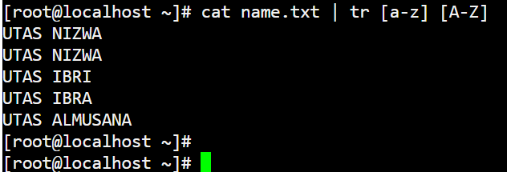
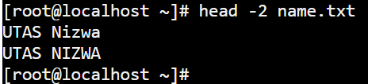
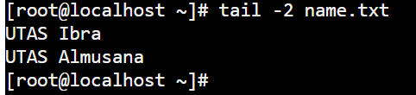
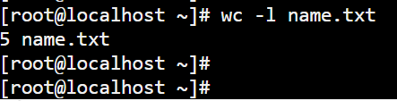
Processing Text Using Filters
tr Convert lowercase to uppercase
tr [a-z] [A-Z]
tr Convert uppercase to lowercase
tr [A-Z] [a-z]
Example: Convert uppercase to lowercase in name.txt file
cat name.txt | tr [a-z] [A-Z]
head (Display First N Lines)
Example: Show first 2 lines
head -2 name.txt
tail (Display Last N Lines)
Example: Show last 2 lines
tail -2 name.txt
wc (Word Count) Counts words, lines, and characters.
Example: count lines in name.txt
wc –l name.txt

Slide 13
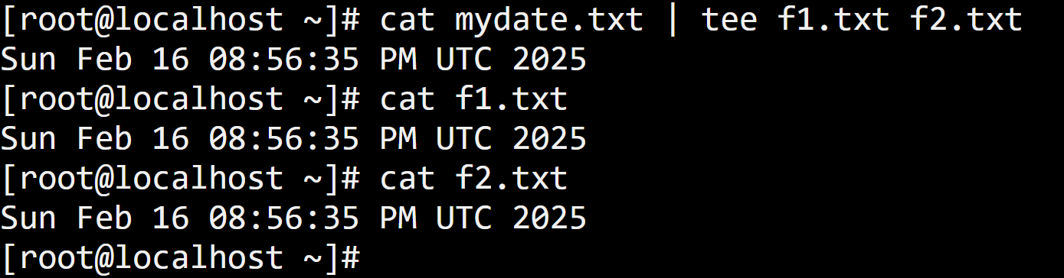
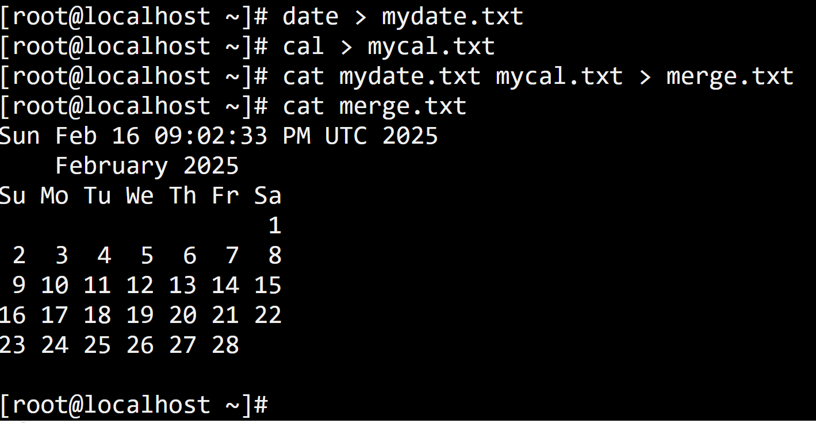
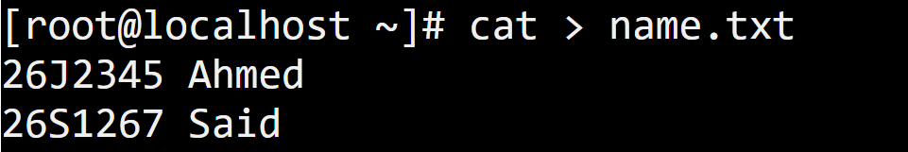
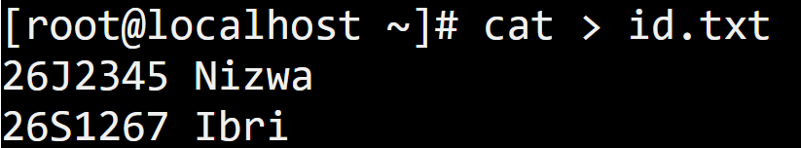
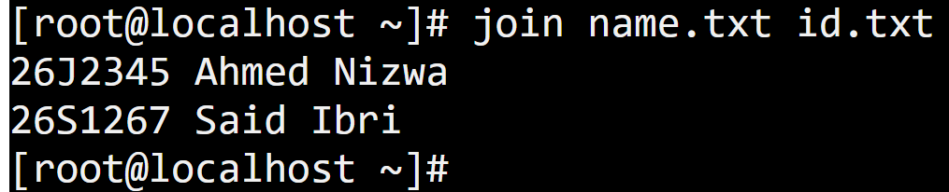
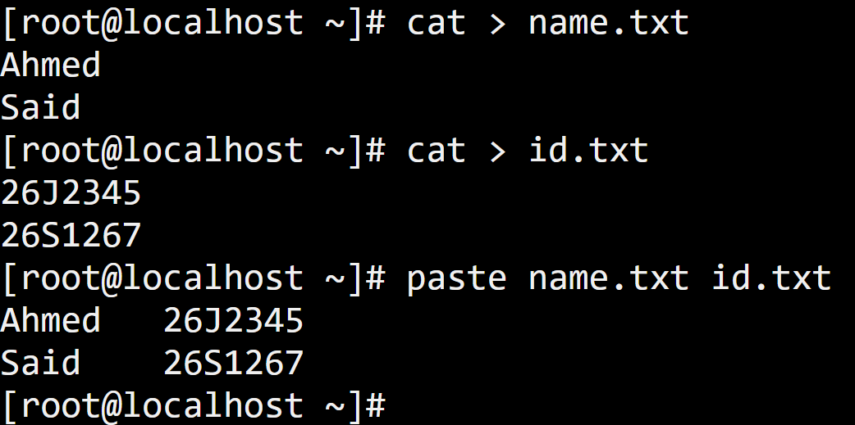
File-Combining Commands
Using tee (Write to Multiple Files)
Using cat (Concatenate Files)
The cat command is the simplest way to combine files.
The paste command is used to merge multiple files line by line.
The tee command sends output to multiple files simultaneously.
The join command is used to merge two files based on a common field (key column).

Slide 14
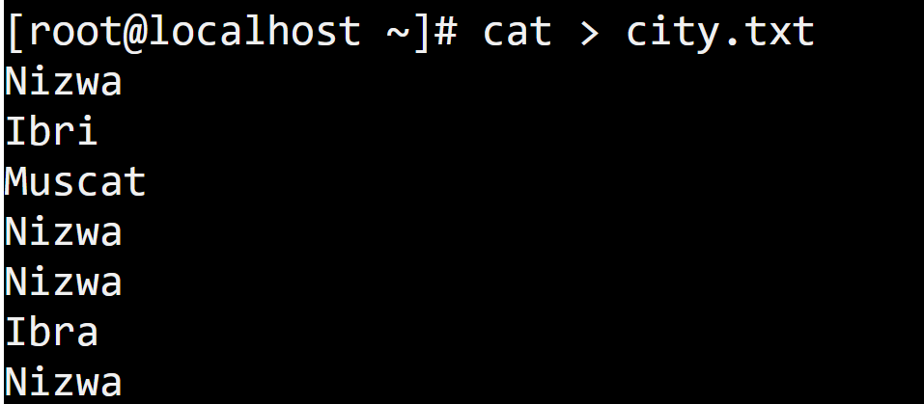
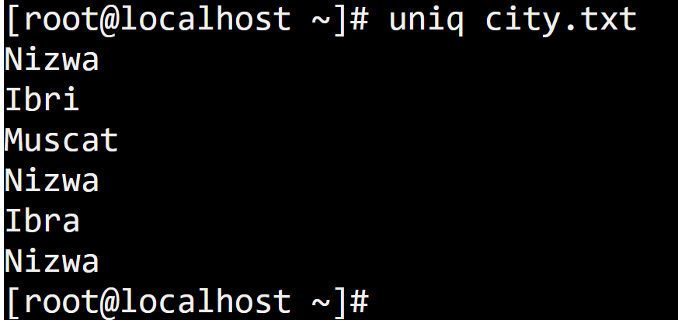
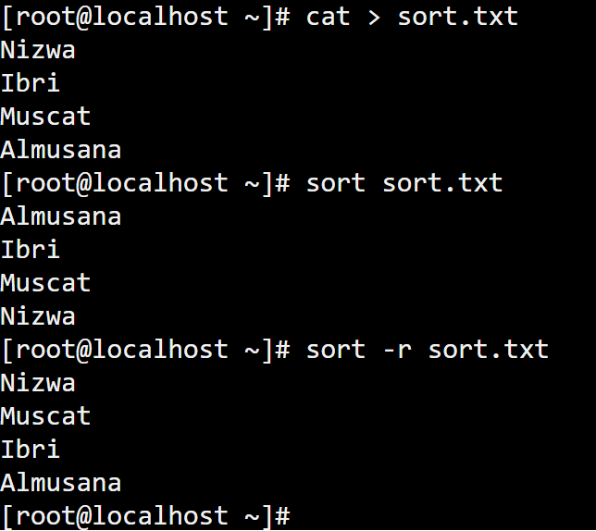
File-Transforming Commands
The uniq command in Linux is used to filter out duplicate lines in a file.
Create file city.txt
sort (Sort File Content)
The sort command arranges lines in order(ascending order)
sort in Reverse Order using -r option(descending order)

Slide 15
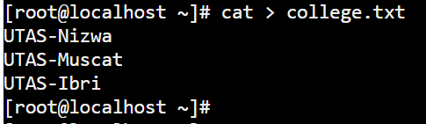
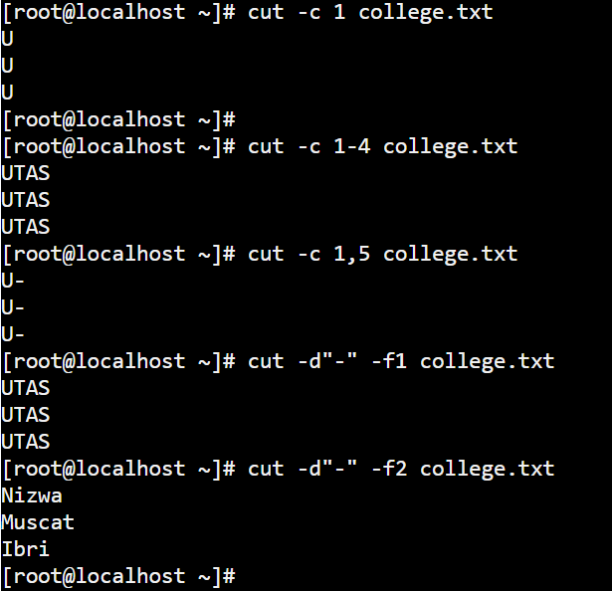
File-Transforming Commands
cut Command in Linux
The cut command is used to extract specific sections of text from a file or input stream. It is commonly used for working with structured text files (CSV, logs, tables, etc.).
Create a file college.txt
-c Select specific characters
-d Specify a delimiter
-f Select specific fields (columns)

Slide 16
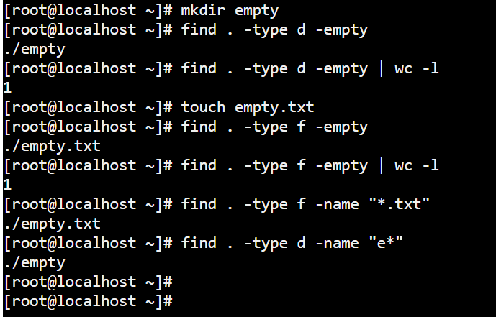
File-Transforming Commands
find command is used to search and locate the list of files and directories based on conditions you specify for files that match the arguments. For example find empty files. The find command is used to search for files and directories based on name, type, size, date, and other criteria.
File -type f
Directory -type d
. (dot) represents the current directory.

Slide 17

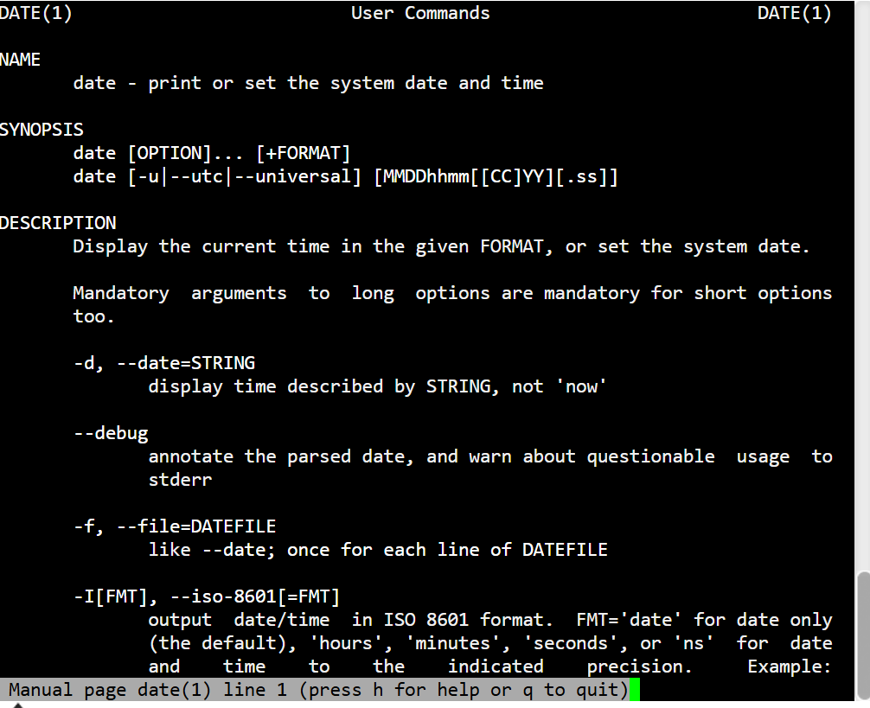

File-Viewing Commands
more Command in Linux
The more command is used to view the content of a file in a page-by-page manner. It is useful when the file content is too large to fit on one screen, allowing you to view it sequentially.
man date > datehelp.txt
more datehelp.txt
The man command stands for manual and is used to display the manual pages (documentation) for other commands and programs in Linux. It provides detailed information on usage, options, and syntax of commands, making it an essential tool for anyone using the Linux command line.
file (Determine the File Type)
🔹 Displays the file type of filename.

Slide 18
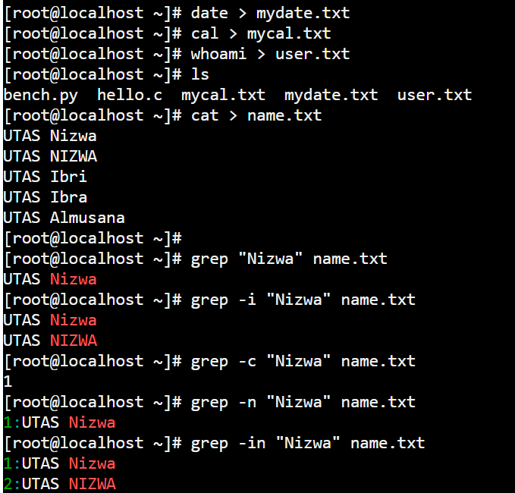
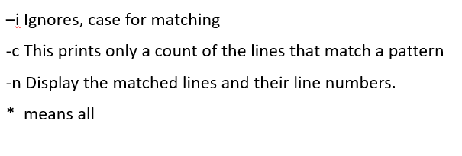
Using grep utility
grep Command in Linux–i Ignores, case for matching
-c This prints only a count of the lines that match a pattern
-n Display the matched lines and their line numbers.
* symbol which stands for "everything"
The grep command is one of the most powerful search utilities in Linux. It is used to search for specific patterns within files. The pattern can be a simple string or a more complex regular expression. Examples,

Slide 19
Piping Data between Programs
What is Piping (|) in Linux?
Piping (|) allows you to send the output of one command as input to another command. It is a way to combine multiple commands efficiently.
1. Basic Pipe Syntax
command1 | command2
command1 produces output → command2 uses that output as input.
2. Examples of Using Pipes (|)
Example 1: Count the Number of Files
ls | wc -l
ls lists files → wc -l counts the lines (number of files).
Example 2: Show Only the First Few Lines of a File
cat file.txt | head -5
cat displays file content → head -n 5 shows only the first 5 lines.
Example 3: Find Specific Words in a File
cat file.txt | grep "Linux"
cat prints file content → grep searches for "Linux" in the file.
Example 4: Sorting and Removing Duplicates
cat names.txt | sort | uniq
sort arranges lines alphabetically → uniq removes duplicates.

Slide 20
Chapter 4: Managing Process
• Understanding the Kernel process
• Understanding Foreground and
• Background Processes
• Examining Process Lists
• Killing / Stop Processes

Slide 21
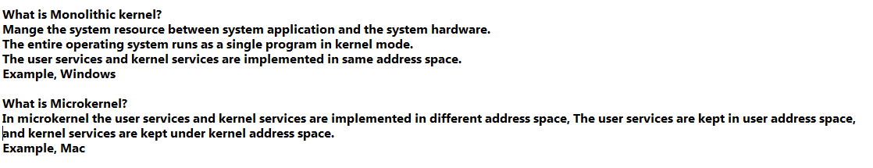
What is the Linux kernel? The Linux kernel is the main component of a Linux operating system (OS) and is the core interface between a computer's hardware and its processes. It communicates between the two, managing resources as efficiently as possible
Types of kernels
In general, we have three types of kernels, and they are,
Monolithic kernel: It contains many device drivers that create a communication interface between the hardware and software of a device.
Microkernel: It could only execute basic functionality.
Hybrid kernel: it combines the aspects of Monolithic kernel and Microkernel

Slide 22
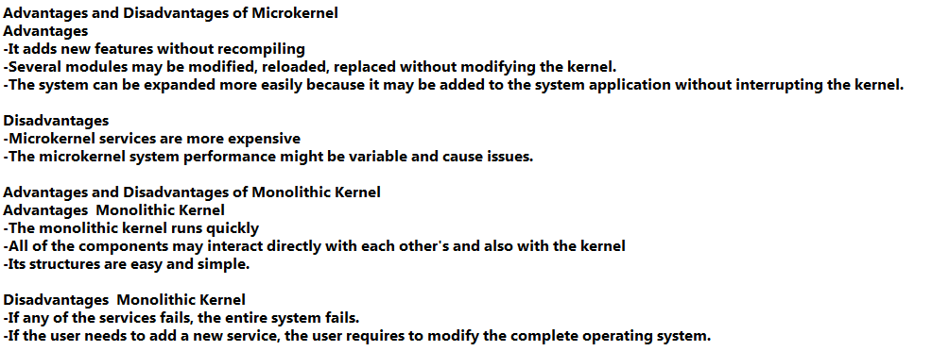

Slide 23
Kernel runtime management and troubleshooting
Find Linux kernel using uname command.
#uname -r
#uname -a
Find Linux kernel using /proc/version file
#cat /proc/version
[root@localhost ~]# dmesg | grep Linux
[ 0.000000] Linux version 4.15.0-00049-ga3b1e7a-dirty (bellard@localhost.loca
ldomain) (gcc version 7.3.0 (Buildroot 2016.08-git-svn30683)) #11 Thu Nov 8 20:30:26 CET 2018
[root@localhost ~]#
uname -a
uname -o
uname -r
uname -v
-a – Display all information
-o – Display the operating system
-r – Display kernel release
-v – Display kernel version

Slide 24
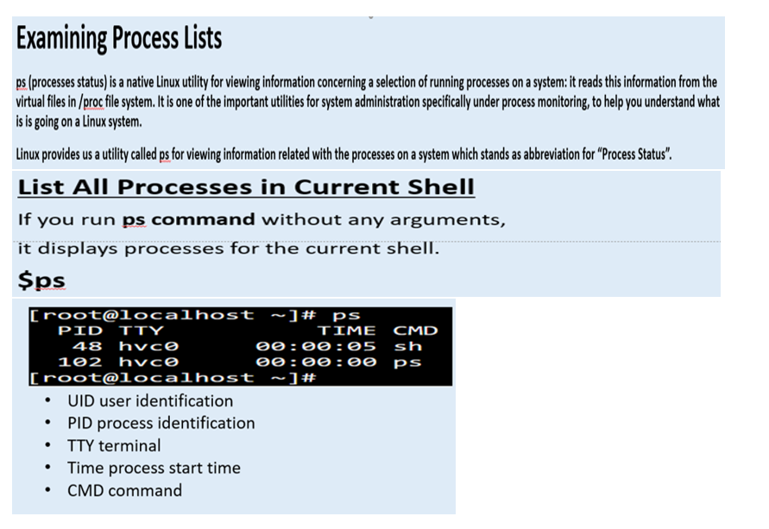
Understanding the Kernel: The First Process
The Linux kernel is at the heart of every Linux system. Although you can’t manage the kernel process in quite the way you can manage other processes, short of rebooting the computer, you can learn about it. To do so, you can use the uname command.

Slide 25
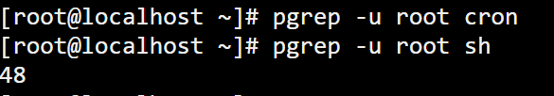
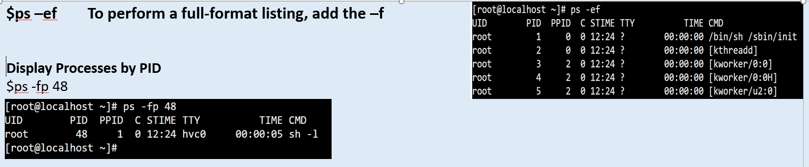
The pgrep command was introduced in the Solaris operating system, but it has been ported to the open-source world and is becoming more popular in Linux. It allows you to perform simple searches within the process list; similar to piping the ps command output to the grep command.

Slide 26
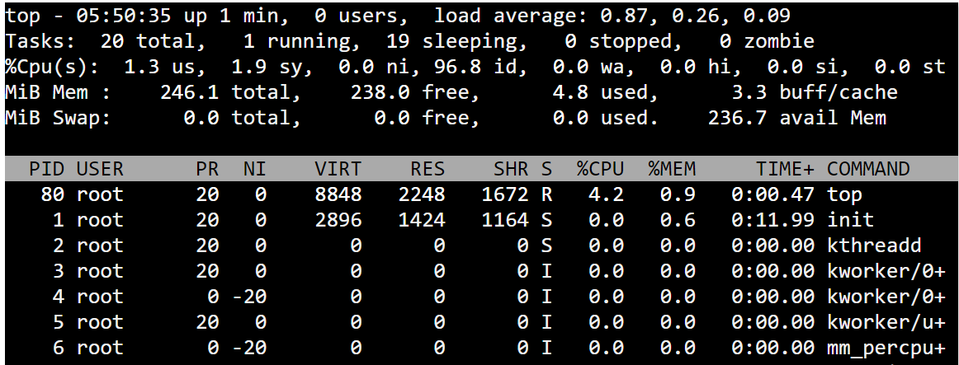
top command
top command is used to show the Linux processes. It provides a dynamic real-time view of the running system. Usually, this command shows the summary information of the system and the list of processes or threads which are currently managed by the Linux Kernel.
$top
Display Specific User Process
Use top command with ‘u‘ option will display
Specific User process details.
# top -u root

Slide 27
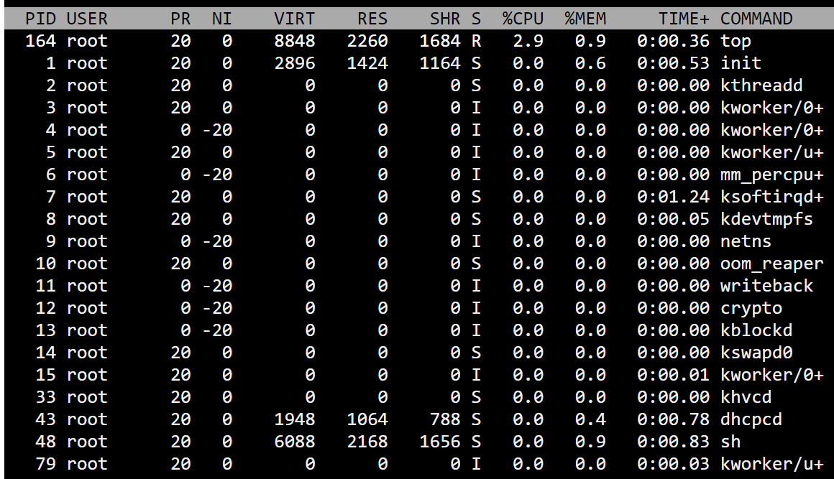
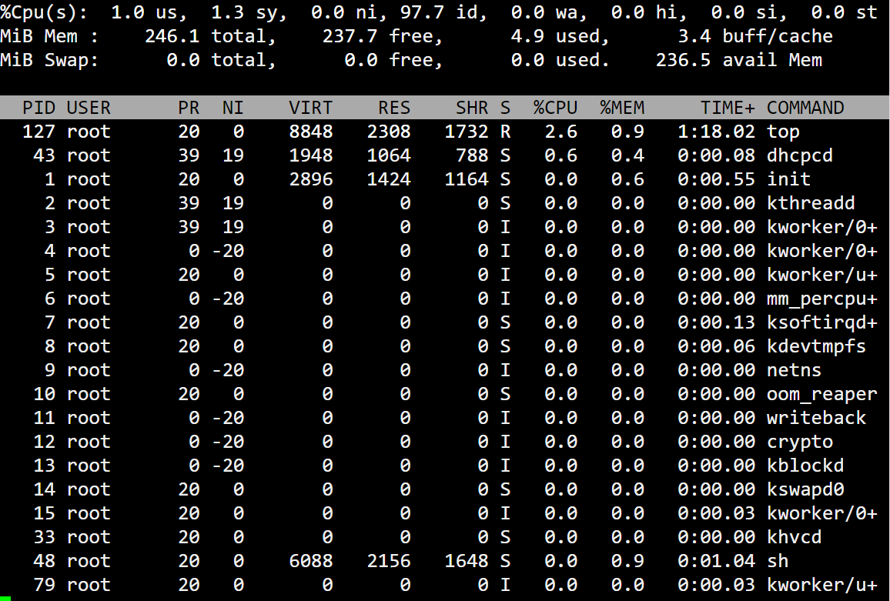
renice command
The renice command allows you to change and modify the scheduling priority of an already running process. Linux Kernel schedules the process and allocates CPU time accordingly for each of them.

Slide 28
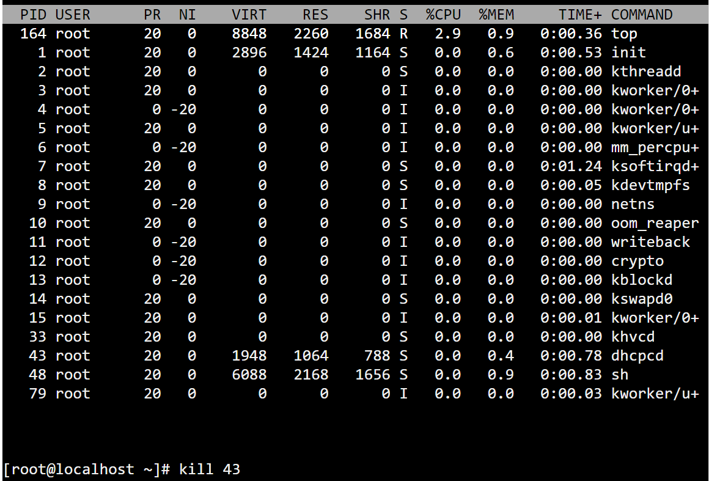
Kill command
The kill command is usually used to kill a process.
$kill processid

Slide 29
Chapter 5: User & Group Management
•Understanding Users and Groups
•Configuring User Accounts (Add, Modify and Delete)
•Configuring Groups (Add, modify and Delete)
•Viewing Individual Account Records

Slide 30
Managing Users and Groups
Adding User Accounts
To add a new user account, you can run either of the following two commands as root.
# adduser [new_account]
# useradd [new_account]
# adduser Linux
# useradd Linux
Understanding /etc/passwd
The full account information is stored in the /etc/passwd file. This file contains a record per system user account.
Understanding /etc/group
Group information is stored in the /etc/group file.

Slide 31
Add user id to existing user.
#usermod -u 100 Linux
Modify or update user id to existing user.
#usermod -u 200 Linux
Delete or remove existing user.
#userdel Linux
Change the username
(for example existing user as “ temp” and change this name as “TEST”)
#usermod –l TEST temp

Slide 32
Adding groups
Creating a new group for read and write access to files that need to be accessed by several users.
#groupadd IT-Network
Add group id to group
#groupmod –g 500 IT-Network
Add Linux user to IT-Network group
#usermod -aG IT-Network Linux
groupmod command in Linux is used to modify or change the existing group on Linux system. It can be handled by superuser or root user.
-g, –gid GID: The group ID of the given GROUP will be changed to GID.

Slide 33
Below command will change the group group_old to group_new using -n option.
#groupmod -n group_new group_old
-n, –new-name NEW_GROUP: The name of group will change into newname.
Delete or remove existing group
#groupdel Linux
groups used to display group name for particular user
#groups Linux

Slide 34
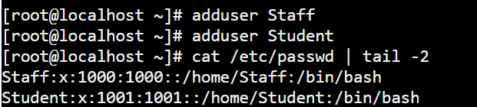

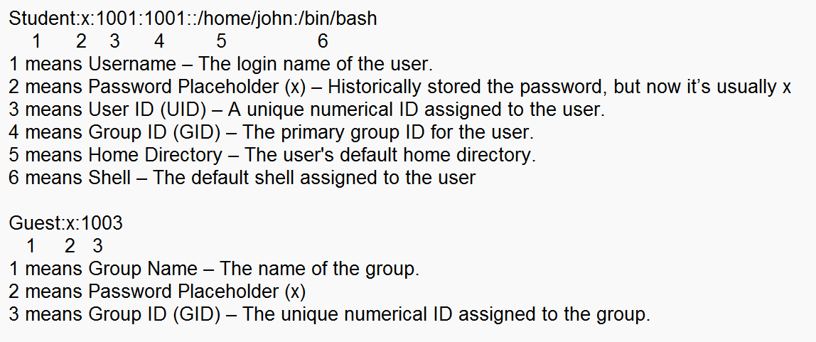
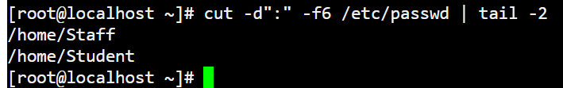
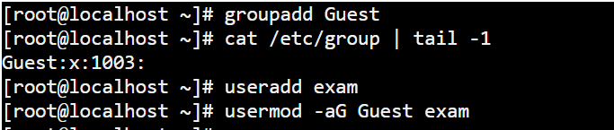
Viewing Individual Account Records
Display current created users name only.
Display current created users.
Display current created user home directory only.
Display current created groups.
Add user exam to Guest group
Display the username of Guest group.

